Slide 1

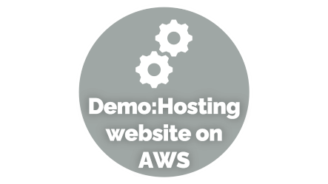



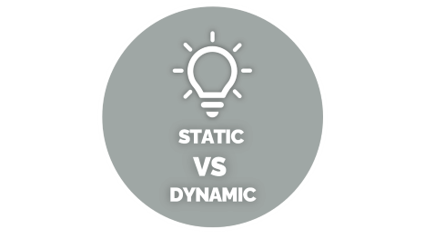


Host Static Website
On AWS
Notes:
https://unsplash.com/photos/AXu2aZ3YgP8

Slide 2

STATIC
VS
DYNAMIC

Slide 3

STATIC VS DYNAMIC
Static website is the basic type of website that is easy to create. You don't need the knowledge of web programming and database design to create a static website. Its web pages are coded in HTML.
Dynamic website is a collection of dynamic web pages whose content changes dynamically. It accesses content from a database Therefore, when you alter or update the content of the database, the content of the website is also altered or updated.
Notes:
https://unsplash.com/photos/fItRJ7AHak8

Slide 4

WHY S3

Slide 5
WHY S3
S3 Bucket Host only static websites significant cut in
costs and no server used while in EC2 – server cost is incurred and backend is required and in Elastic Beanstalk also server cost is incurred and PHP used as server tech
So we use S3 Bucket as it keeps track of deployed websites with no maintenance , always virtually available and massive reduction on cost
Notes:
https://unsplash.com/photos/48nerZQCHgo

Slide 6

WHAT IS S3

Slide 7

WHAT IS S3
Amazon S3 (Simple Storage Service) provides object storage, which is built for storing and recovering any amount of information or data from anywhere over the internet. It provides this storage through a web services interface
Storage service
Free tier accessible
5GB free storage
No server needed
Cost effective
Notes:
https://unsplash.com/photos/TvN54bnuQg8

Slide 8

Demo:Hosting website on AWS

Slide 9
Demo:Hosting website on AWS
Notes:
https://unsplash.com/photos/GKLIsLZxhj0

Slide 10
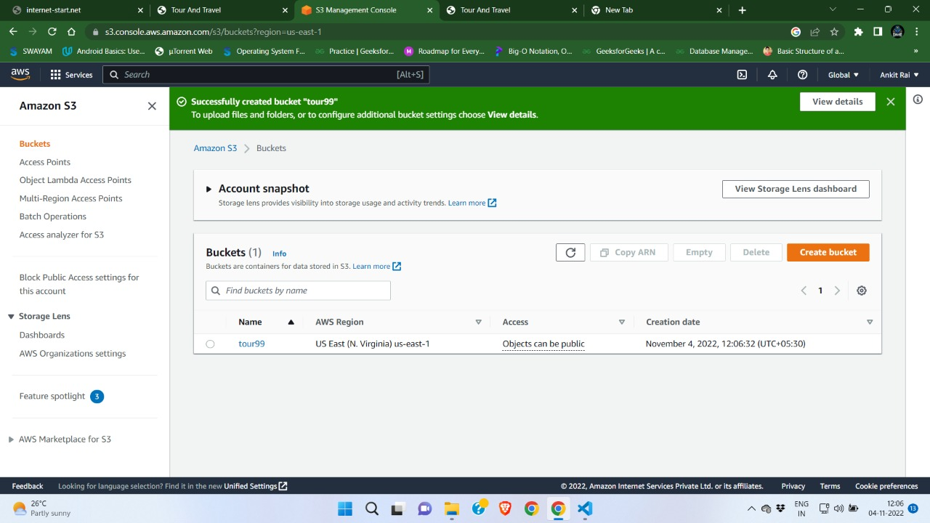

Slide 11
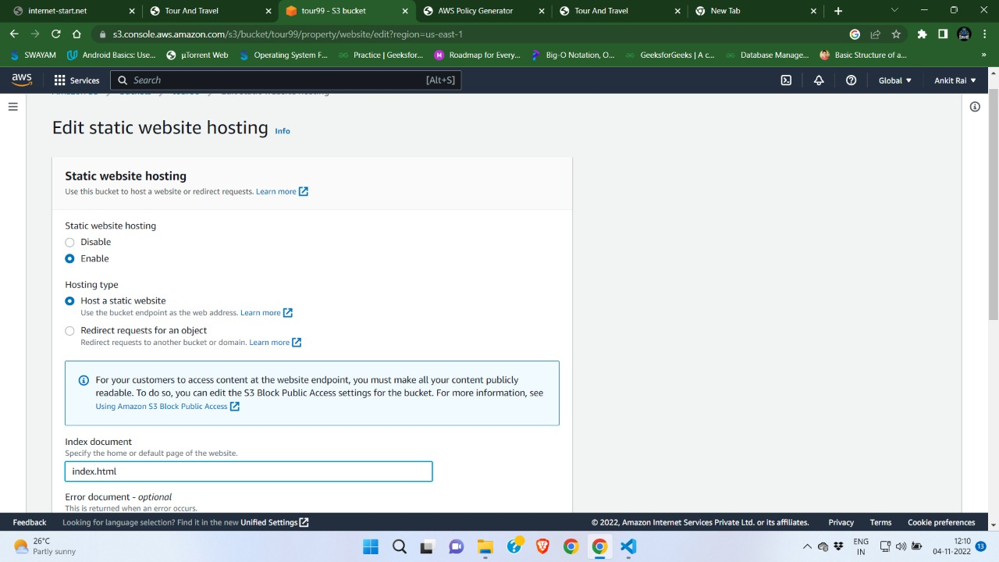

Slide 12
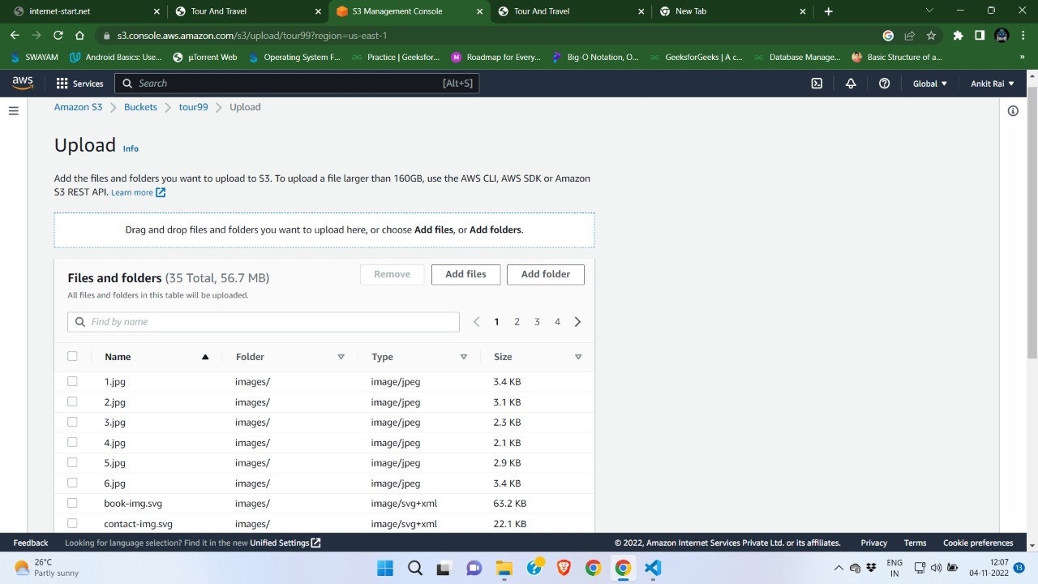

Slide 13
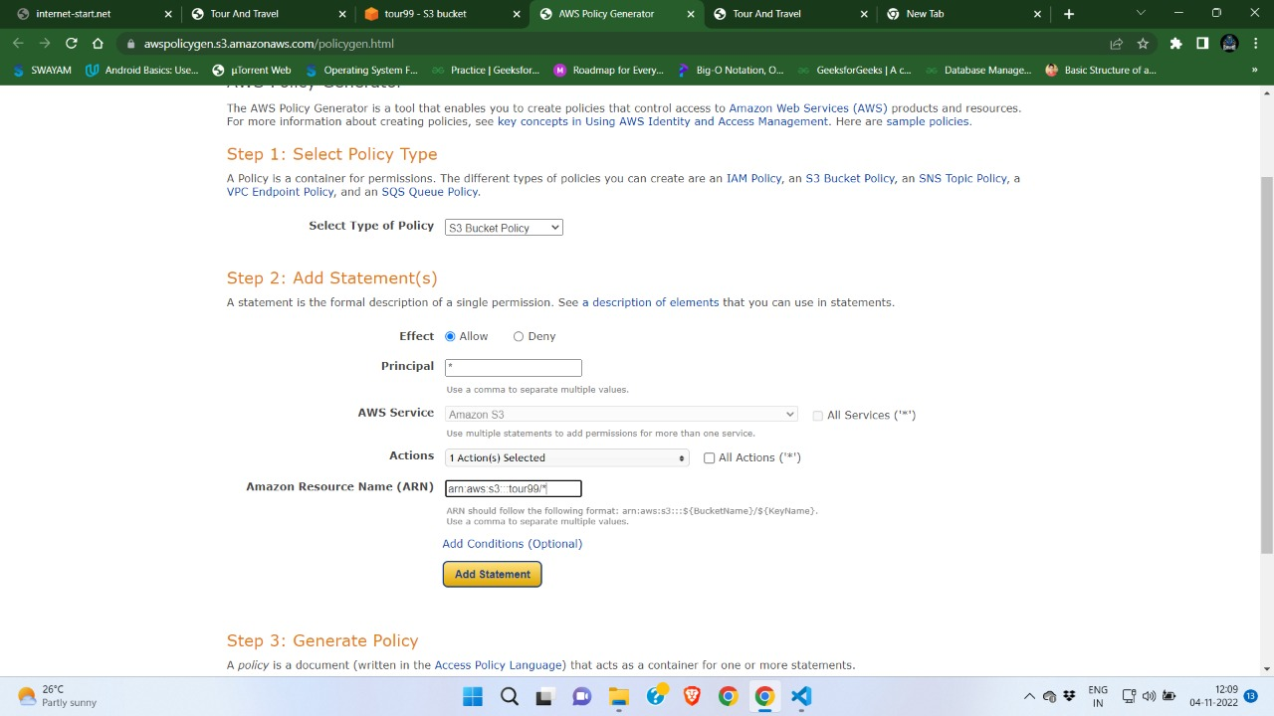

Slide 14
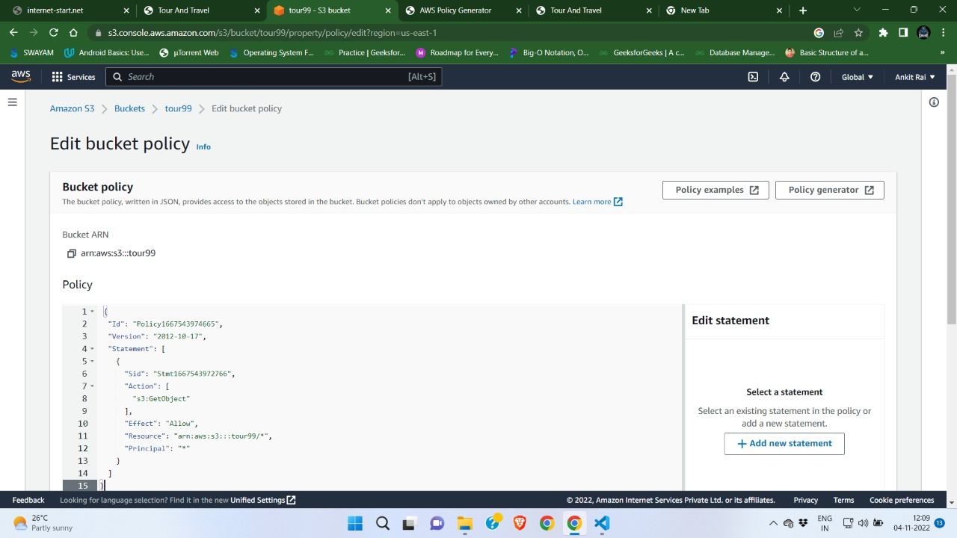

Slide 15
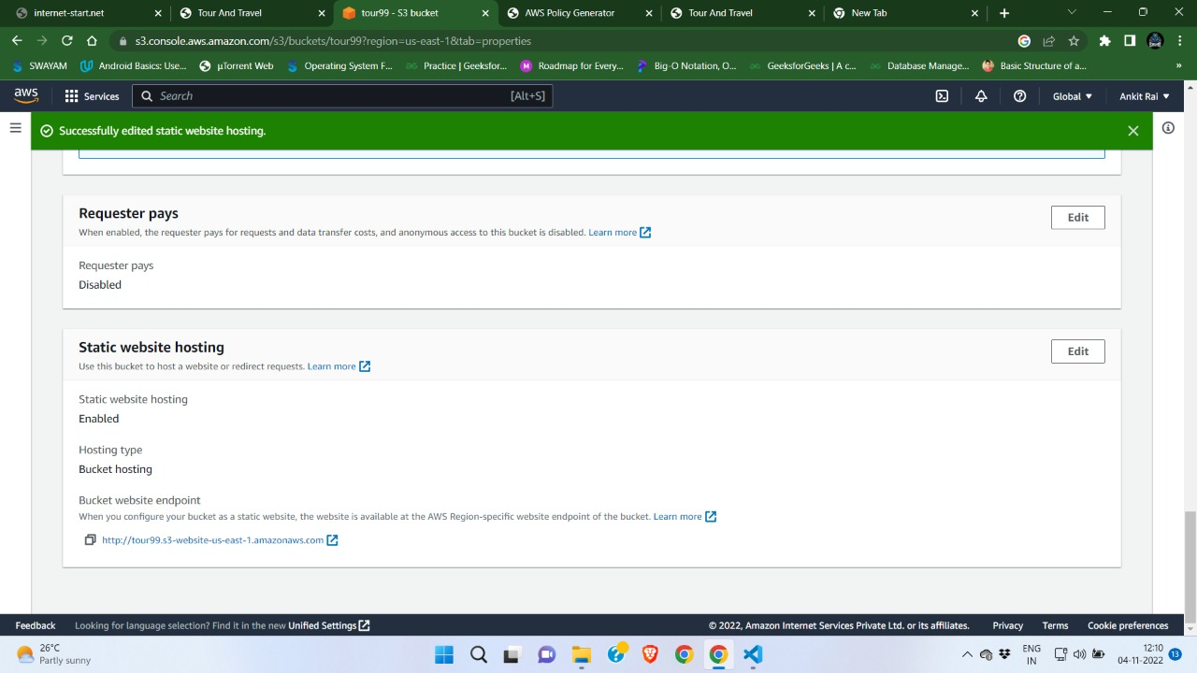

Slide 16
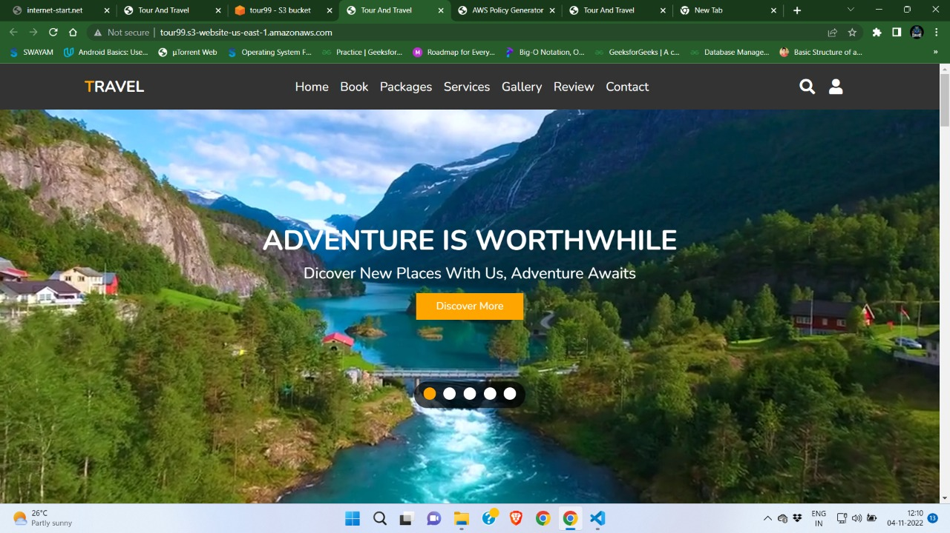

Slide 17
THANK YOU

